Slide 1
Virtualization

Slide 2
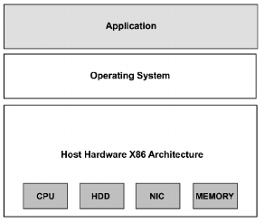
Before virtualization
Fig 1. A machine before virtualization

Slide 3
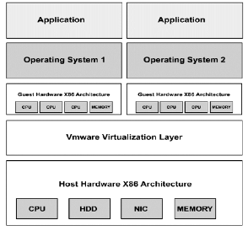
After virtualization
Fig2. After virtualization

Slide 4
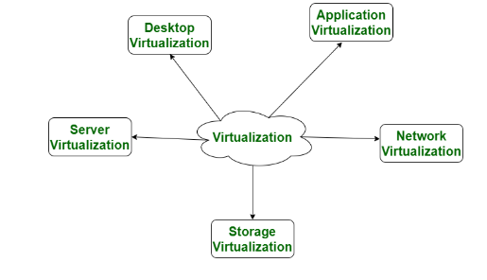
Types of Virtualization:

Slide 5
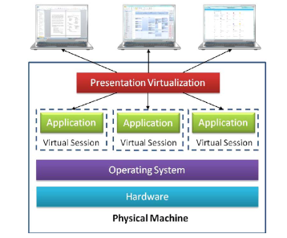
Application Virtualization

Slide 6
Application Virtualization:
The virtualization of applications in the host machine without modifying the host machine or the OS, File System, or Registry.
Application virtualization helps a user to have remote access of an application from a server.
The server stores all personal information and other characteristics of the application but can still run on a local workstation through the internet.
With the application virtualization technology, organizations can easily deploy custom/commercial applications across the organization without installation conflicts, system changes etc

Slide 7
Benefits of Application Virtualization:
• It ensures faster spread of the software
• Full Portability: Applications that are virtualized can be accessed and shared from any network without the aid of a local server.
Increased efficiency of application deployment
Supportability: Virtualized application does not require modifications of administrative or security permission for installation
Example of this would be a user who needs to run two different versions of the same software.
Technologies that use application virtualization are hosted applications and packaged applications.

Slide 8
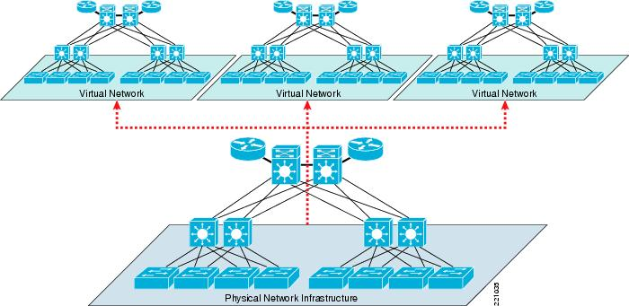
Network Virtualization

Slide 9
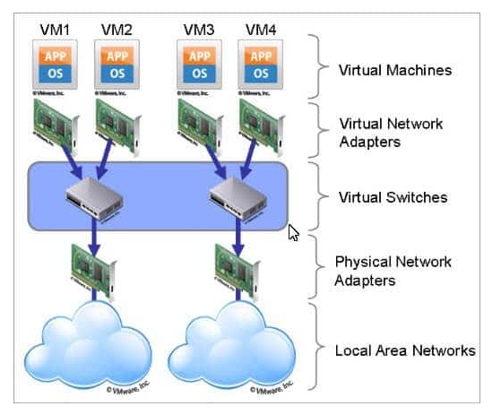
Network Virtualization

Slide 10
Network Virtualization:
The ability to run multiple virtual networks with each has a separate control and data plan.
It co-exists together on top of one physical network.
It can be managed by individual parties that potentially confidential to each other.
Network virtualization provides a facility to create and provision virtual networks—logical switches, routers, firewalls, load balancer, Virtual Private Network (VPN), and workload security within days or even in weeks.

Slide 11
What is network virtualization ?
Network virtualization is the process of combining hardware and software network resources and network functionality into a single, software-based administrative entity, a virtual network.
Two categories :
External network virtualization
Combine many networks, or parts of networks, into a virtual unit.
Internal network virtualization
Provide network-like functionality to the software containers on a single system.

Slide 12
Properties of network virtualization
:
1.Scalability
Easy to extend resources in need
Administrator can dynamically create or delete virtual network connection
2.Resilience
Recover from the failures
Virtual network will automatically redirect packets by redundant links
3.Security
Increased path isolation and user segmentation
Virtual network should work with firewall software
4.Availability
Access network resource anytime

Slide 13
Desktop Virtualization:
Desktop virtualization allows the users’ OS to be remotely stored on a server in the data centre.
It allows the user to access their desktop virtually, from any location by a different machine.
Users who want specific operating systems other than Windows Server will need to have a virtual desktop.
Main benefits of desktop virtualization are user mobility, portability, easy management of software installation, updates, and patches.

Slide 14
Example:
If you are an employee of an organization working remotely due to COVID-19 and want to access company resources for your work. Using the desktop, laptop, tablet, or mobile device, you can access the resources anywhere, no matter what operating system you use.
This can be used as a disaster recovery strategy. Since all the components are saved in your data centers, you can restore the lost data from other devices using the desktop virtualization.

Slide 15
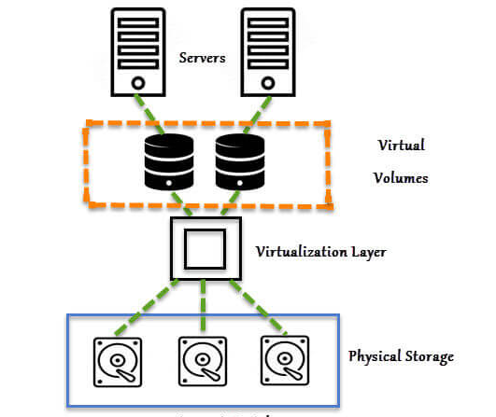
Storage Virtualization:

Slide 16
Storage Virtualization
There are 2 servers with the virtual volumes. These virtual volumes may be mapped to different applications.
Between the actual storage and the virtual volume there is virtualization layer which helps in redirecting the I/O
The physical storage or hard disks are combined or grouped together.
then with the help of virtualization software this physical disks are divided into small blocks of data as per the requirements,
which is presented to remote servers as a virtual disk.
These virtual blocks of data look as the physical disk to the server.

Slide 17
Storage Virtualization:
Storage virtualization is an array of servers that are managed by a virtual storage system.
The servers aren’t aware of exactly where their data is stored, and instead function more like worker bees in a hive.
It makes managing storage from multiple sources to be managed and utilized as a single repository.
storage virtualization software maintains smooth operations, consistent performance and a continuous suite of advanced functions despite changes, break down and differences in the underlying equipment.

Slide 18
Storage Virtualization: Advantages
It is highly scalable.
It allows easy addition and deletion of storage without affecting any application.
Easy data migration.
Easy storage management.

Slide 19
Server Virtualization
This is a kind of virtualization in which masking of server resources takes place.
Here, the central-server(physical server) is divided into multiple different virtual servers by changing the identity number, processors.
So, each system can operate its own operating systems in isolate manner.
Where each sub-server knows the identity of the central server.
It causes an increase in the performance and reduces the operating cost by the deployment of main server resources into a sub-server resource.
It’s beneficial in virtual migration, reduce energy consumption, reduce infrastructural cost, etc.

Slide 20
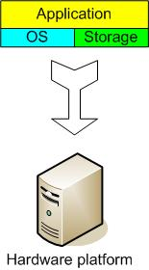
The traditional server concept
Web Server
Windows
IIS
App Server
Linux
Glassfish
DB Server
Linux
MySQL
EMail
Windows
Exchange

Slide 21
And if something goes wrong…..
Web Server
Windows
IIS
App Server
DOWN!
DB Server
Linux
MySQL
EMail
Windows
Exchange

Slide 22
System Administrators often talk about servers as a whole unit that includes the hardware, the OS, the storage, and the applications.
Servers are often referred to by their function i.e. the Exchange server, the SQL server, the File server, etc.
If the File server fills up, or the Exchange server becomes overtaxed, then the System Administrators must add in a new server.

Slide 23
Unless there are multiple servers, if a service experiences a hardware failure, then the service is down.
System Admins can implement clusters of servers to make them more fault tolerant.
However, even clusters have limits on their scalability, and not all applications work in a clustered environment.

Slide 24
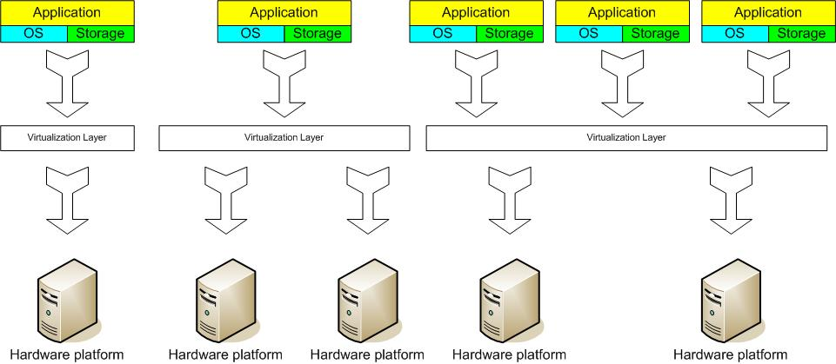
Virtual server concept
Virtual Machine Monitor (VMM) layer between Guest OS and hardware

Slide 25
Virtual server
Virtual servers seek to encapsulate the server software away from the hardware
This includes the OS, the applications, and the storage for that server.
Servers end up as mere files stored on a physical box, or in enterprise storage.
A virtual server can be serviced by one or more hosts, and one host may house more than one virtual server.

Slide 26
Virtual server
Virtual servers can still be referred to by their function i.e. email server, database server, etc.
If the environment is built correctly, virtual servers will not be affected by the loss of a host.
Hosts may be removed and introduced almost at will to accommodate maintenance.

Slide 27
Virtual server
Virtual servers can be scaled out easily.
If the administrators find that the resources supporting a virtual server are being taxed too much, they can adjust the amount of resources allocated to that virtual server
Server templates can be created in a virtual environment to be used to create multiple, identical virtual servers
Virtual servers themselves can be migrated from host to host almost at will.

Slide 28
Virtual server
Advantages
Resource pooling
Highly redundant
Highly available
Rapidly deploy new servers
Easy to deploy
Reconfigurable while services are running
Optimizes physical resources by doing more with less
Disadvantages
Slightly harder to conceptualize
Slightly more costly (must buy hardware, OS, Apps, and now the abstraction layer)

Slide 29
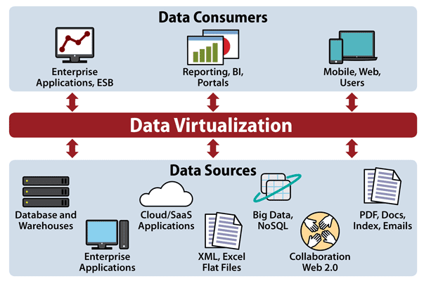
Data virtualization

Slide 30
Data virtualization:
This is the kind of virtualization in which the data is collected from various sources and managed that at a single place without knowing more about the technical information like how data is collected, stored & formatted then arranged that data logically
so that its virtual view can be accessed by its interested people and stakeholders, and users through the various cloud services remotely.
Many big giant companies are providing their services like Oracle, IBM, At scale, Cdata, etc.

Slide 31
Data virtualization: Advantages
Cost savings: It’s cheaper to store and maintain data than it is to replicate and spend resources transforming it to different formats and locations.
Logical abstraction and decoupling: Heterogeneous data sources can now interact more easily through data virtualization.
Data governance: Through central management, data governance challenges can be lessened, and rules can be more easily applied to all of the data from one location.

Slide 32
Data virtualization: Advantages
Bridging structured and unstructured: Data virtualization can bridge the semantic differences of unstructured and structured data, integration is easier and data quality improves across the board.
Increased productivity: Aside from the aforementioned bridging of data, virtualization also makes it easier to test and deploy data-driven apps, since less time is needed integrating data sources.

Slide 33
Hypervisor
A hypervisor is a form of virtualization software used in Cloud hosting to divide and allocate the resources on various pieces of hardware.
The program which provides partitioning, isolation, or abstraction is called a virtualization hypervisor.
The hypervisor is a hardware virtualization technique that allows multiple guest operating systems (OS) to run on a single host system at the same time.
A hypervisor is sometimes also called a virtual machine manager(VMM).

Slide 34
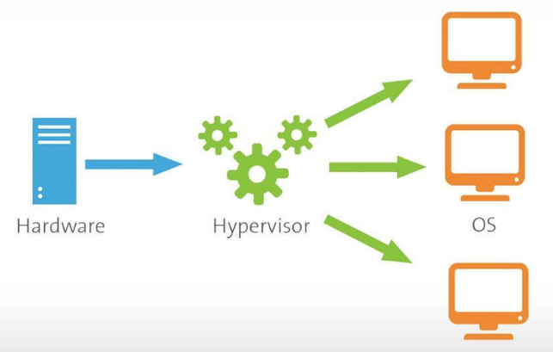
Hypervisor

Slide 35
Types of hypervisors
There are two types of hypervisors:
"Type 1" (also known as "bare metal")
"Type 2" (also known as "hosted").

Slide 36
TYPE-1 Hypervisor:
The hypervisor runs directly on the underlying host system.
It is also known as a “Native Hypervisor” or “Bare metal hypervisor”.
It does not require any base server operating system.
It has direct access to hardware resources.
Examples :
VMware ESXi,
Citrix XenServer,
and Microsoft Hyper-V hypervisor.

Slide 37
Advantages and Disadvantages
Advantages:
Such kinds of hypervisors are very efficient because they have direct access to the physical hardware resources(like Cpu, Memory, Network, and Physical storage).
This causes the empowerment of the security because there is nothing any kind of the third party resource so that attacker couldn’t compromise with anything.
Disadantages:
One problem with Type-1 hypervisors is that they usually need a dedicated separate machine to perform their operation and to instruct different VMs and control the host hardware resources.

Slide 38
TYPE-2 Hypervisor:
A Host operating system runs on the underlying host system.
It is also known as ‘Hosted Hypervisor”.
Such kind of hypervisors doesn’t run directly over the underlying hardware rather they run as an application in a Host system(physical machine).
Basically, the software is installed on an operating system.
Hypervisor asks the operating system to make hardware calls.
Example :
VMware Player or Parallels Desktop.
Hosted hypervisors are often found on endpoints like PCs.
The type-2 hypervisor is very useful for engineers, and security analysts (for checking malware, or malicious source code and newly developed applications).

Slide 39
Advantages and Disadvantages
Advantages:
It allows quick and easy access to a guest Operating System alongside the host machine running.
These hypervisors usually come with additional useful features for guest machines.
Such tools enhance the coordination between the host machine and the guest machine.
Disadvantages:
There is no direct access to the physical hardware resources so the efficiency of these hypervisors lags in performance as compared to the type-1 hypervisors,
potential security risks are also there an attacker can compromise the security weakness if there is access to the host operating system so he can also access the guest operating system.

Slide 40
Benefits of hypervisors
Using a hypervisor to host several virtual machines has many advantages:
Speed:
The hypervisors allow virtual machines to be built instantly unlike bare-metal servers.
This makes provisioning resources for complex workloads much simpler.
Efficiency:
Hypervisors that run multiple virtual machines on the resources of a single physical machine often allow for more effective use of a single physical server.

Slide 41
Flexibility:
The hypervisor distinguishes the OS from the underlying hardware, the program no longer relies on particular hardware devices or drivers,
bare-metal hypervisors enable operating systems and their related applications to operate on a variety of hardware types.
Portability:
Multiple operating systems can run on the same physical server thanks to hypervisors (host machine).
The hypervisor's virtual machines are portable because they are separate from the physical computer.

Slide 42
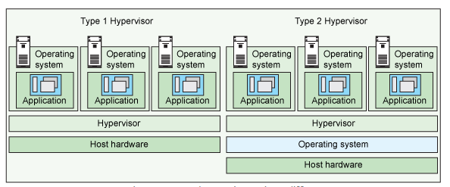
Type 1 and type 2 hypervisor

